Slide 1
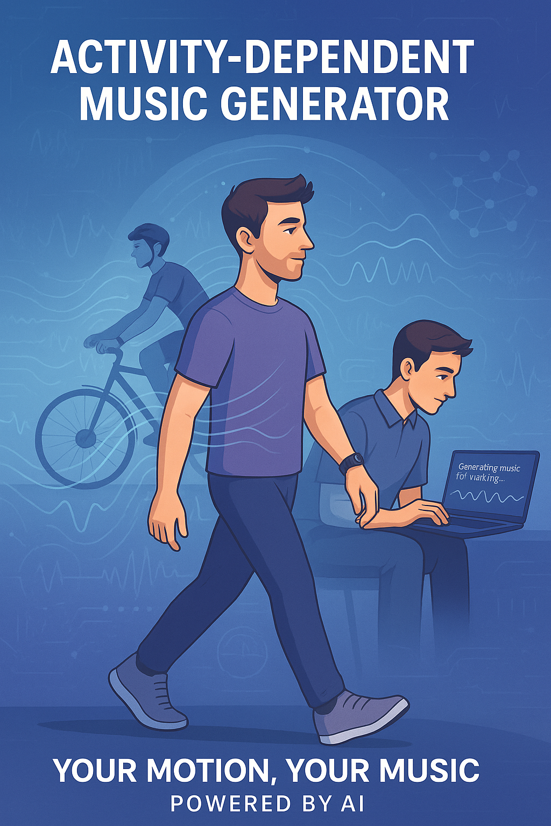
MUSE: User-Sensitive musical Expression
Liam McHugh

Slide 2
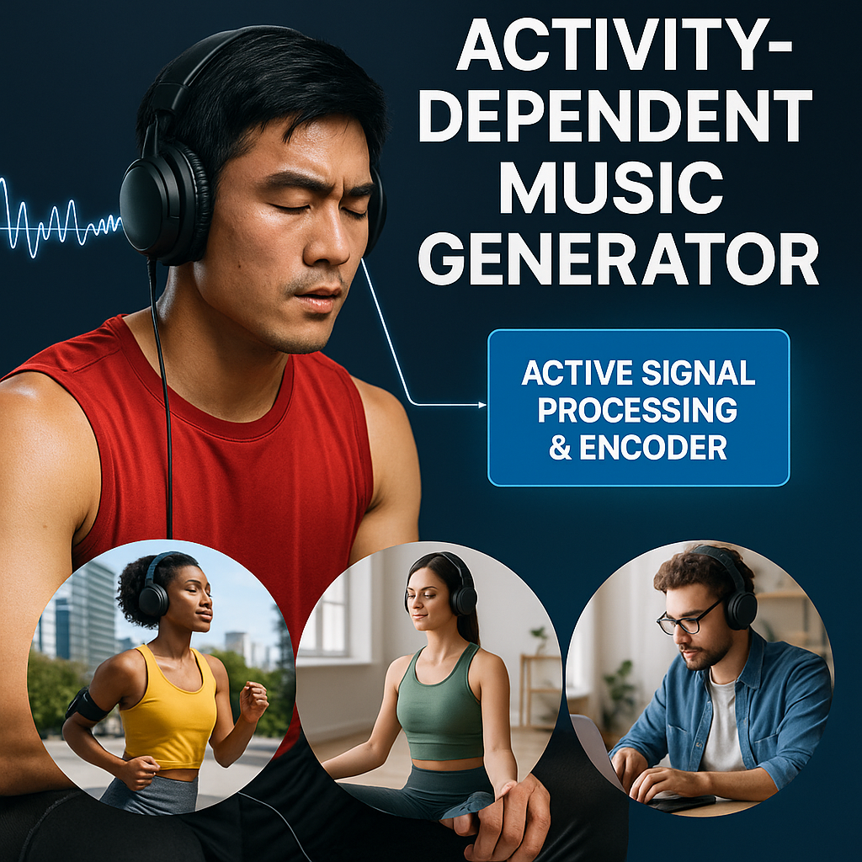
Active Audio Paradigms
Music currently requires playlist management, passive queue.
Even commercial AI in music relies on passive, near-match paradigms…
MUSE INITIATES A PARADIGM SHIFT
Actively create live audio experience with activity-linked, semantically-tuned live audio streaming… Become your own instrument
Control life experience with fine-tuned cognitive congruence.
Project Goals:
Locally process activity signals into interpretable semantics.
Push prompt to MusicGen workers in cloud
Stream generated segments to local audio-player device.
Minimize stream faltering, transition latency & interference

Slide 3
Presentation Agenda
Key References
System Architecture, Development Methodology
SubTask: Local signal processing & activity encoder
SubTask: Latent Info + Audio Decoder
SubTask: Local StreamPlayer
Results:
Streaming System Operation
Challenges & Future Work
Conclusion
Appendix
References

Slide 4
Key References and Links
Github link (project inwork)
Facebook Research’s MusicGen Model Card
MusicGen Fragment Streaming App (Sanchit Gandhi)
SigLIP2 Zero-Shot Image Classification
CoreML - Apple Developer Platform
Spotify’s AI Playlist Generator
State of Generative Music & Audio-Generative Architectures
Prof. DiCarlo’s work on human visual-perceptive control
MIT Media Lab’s Semantic Synth Programming
Mesgarani N.A.P. Lab work on BCI-Augmented Attentional Audio Control

Slide 5
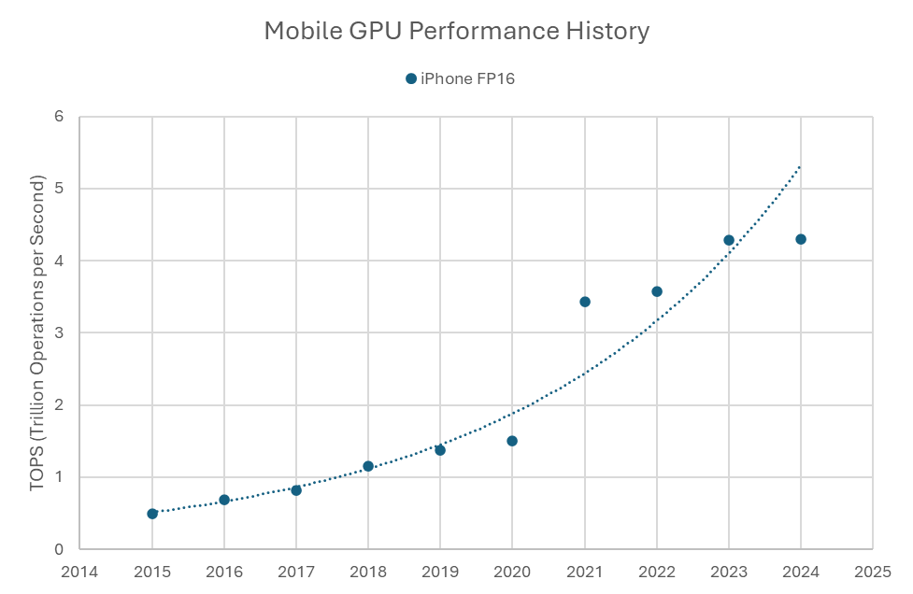
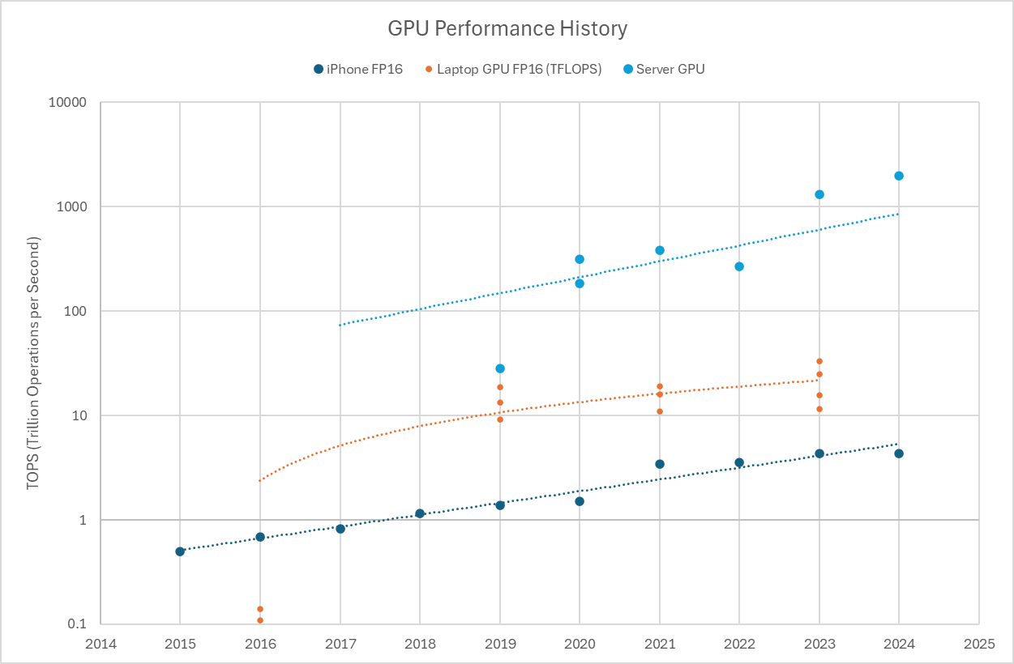
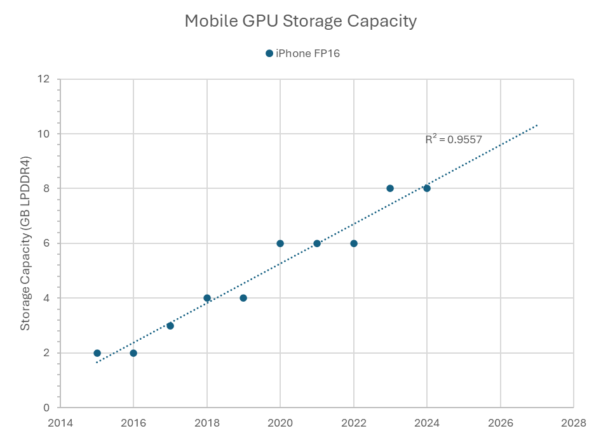
Parallel Computing Performance Paradigms

Slide 6



General Architecture
Wearable Edge Device
Music-Player: Stream Processor
(Condition Prompt)
(Manage Queue)
(Play Audio)
Activity Data
(Accel, HR)
Activity Encoder
Activity Tracking Module
Static Data
(pers. Info)
Prompt Info
Decoder
(context-aware generative)
Music Generation
Wireless Xfr
ToDo

Slide 7
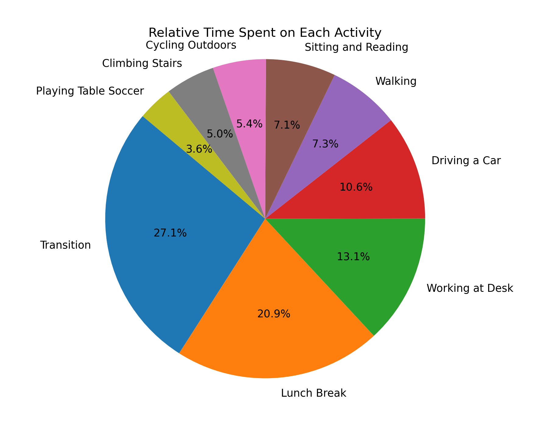
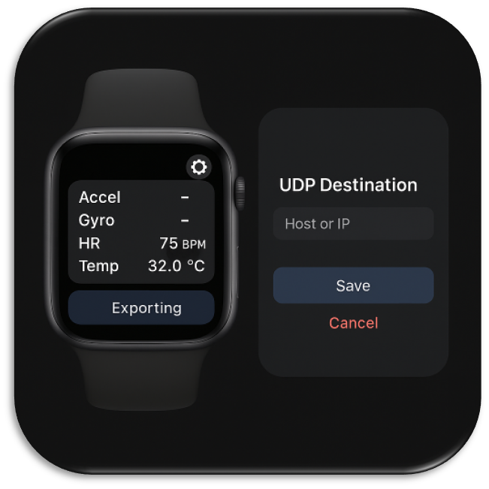
Activity Data
Testing: UC Irvine PPG Dataset (heart-rate, 64Hz wrist accel, activity classes)
128k sec of activity data; 15 subjects, 9 activities (including transition)
(Data Acquisition to be built on WatchOS
w/apple health, CoreMotion, CoreML)
https://archive.ics.uci.edu/dataset/495/ppg%2Bdalia?

Slide 8
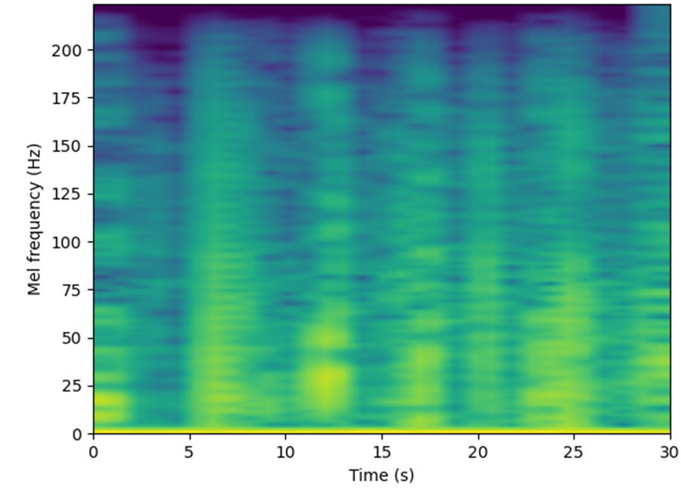
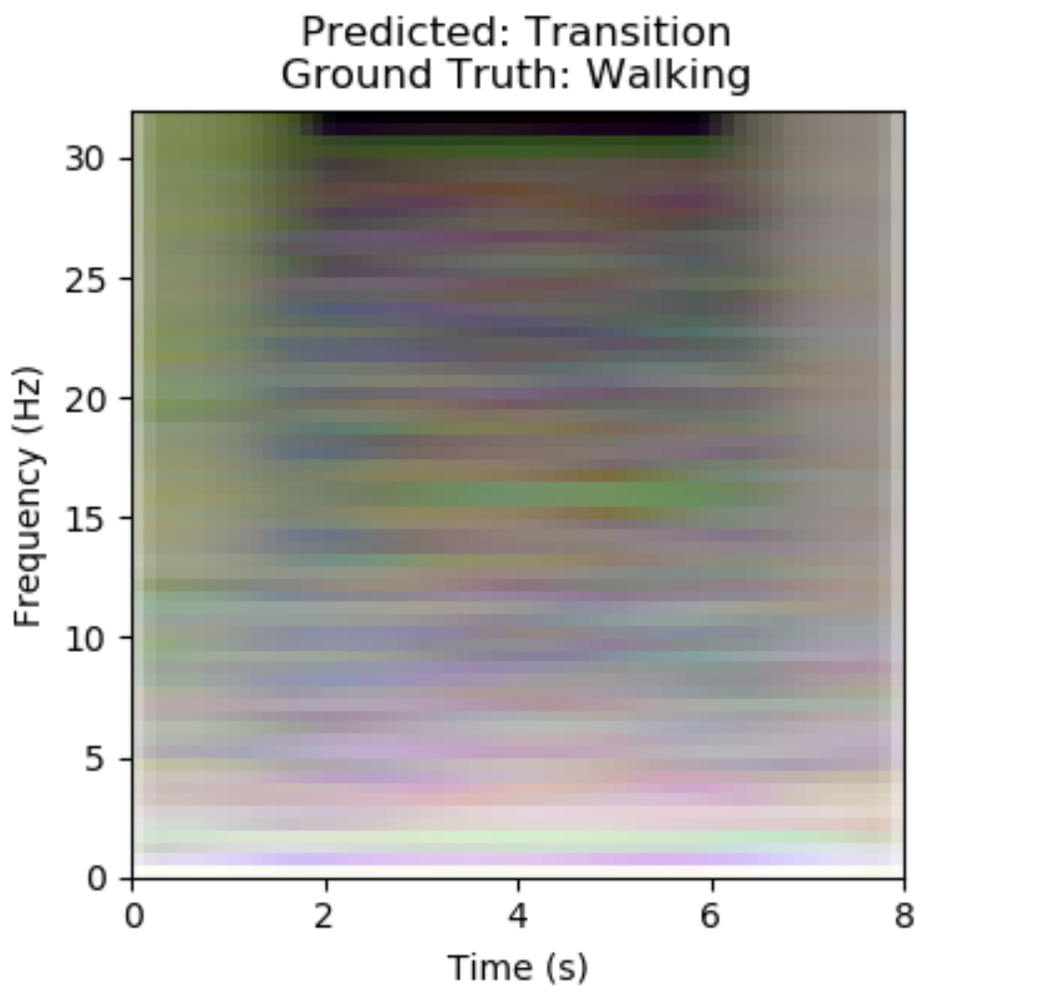
Activity Data Encoder
Mel Spectrogram: Single-Channel (Colorized), 30sec
Architecture Options:
CNN Classifier
Clip-style encoder finetune *
Full VLM w/fine-tuned encoder *
* Seamless MusicGen integration requires text input (can run embeddings w/forward pass adj.)
Raw Edge Device:
SmartWatch (Neural Engine: 0.3-1.2 fp16 TOPS) OR Smartphone
Prototyping: Jetson Nano (0.5 fp16 TOPS)
3-Channel (ACCxyj) Test Frame, 8sec

Slide 9
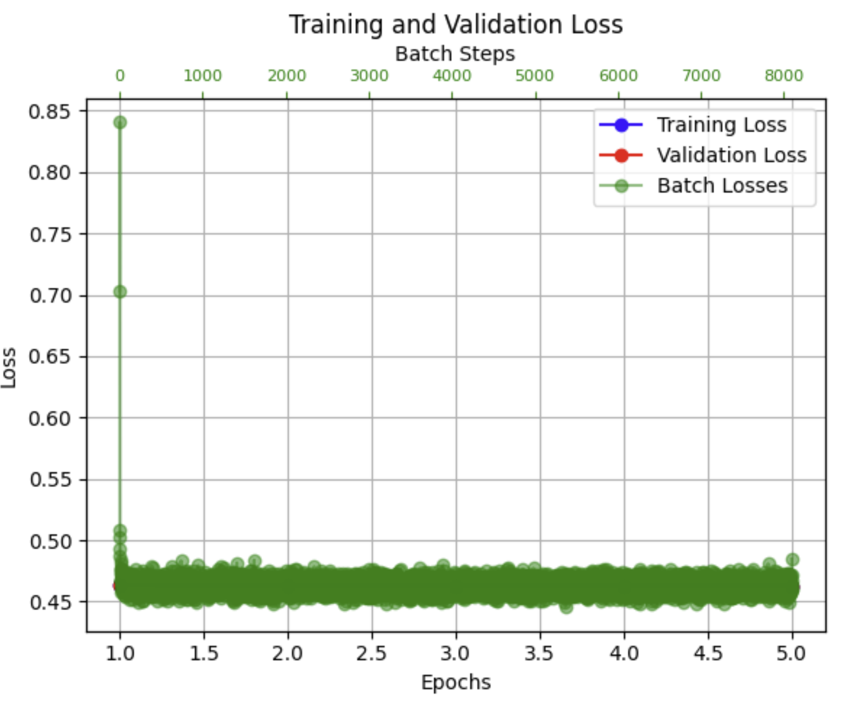
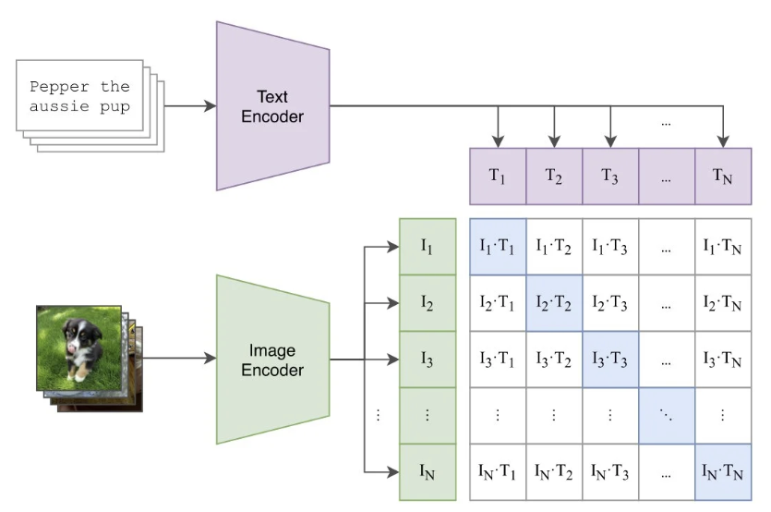

SigLIP Encoder
Data Collection Mechanism for Effective Zero-Shot Pretraining
SigLIP Vit-B: 375M parameter base model (6GB at fp16)
ViT-B(90M) Outputs 768-dim embedding (same as MusigGeninput embedding)
Fine-tuned w/mel spectrogram > 768d text embedding (MG Flan-T5 text embed.) sigmoid token loss
“Climbing Stairs”

Slide 10
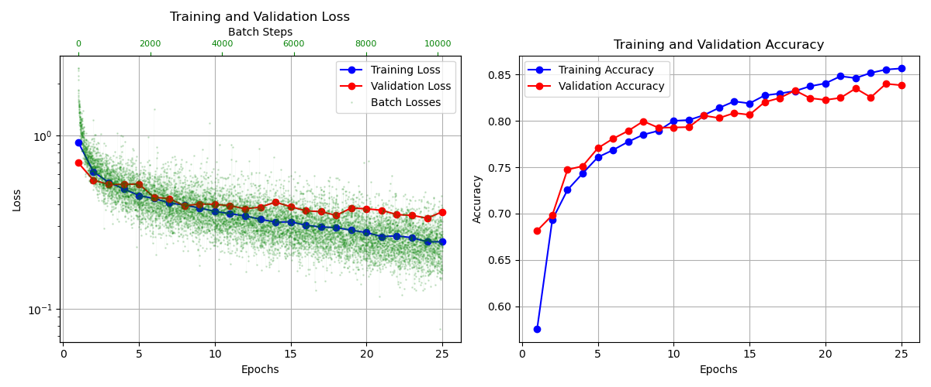
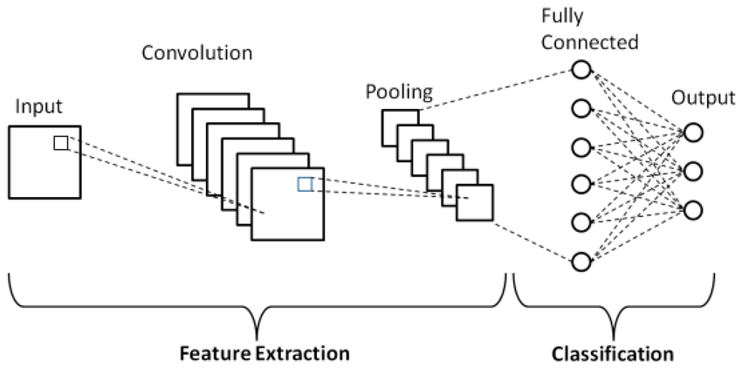
Custom CNN Classifier
~500k parameter model
Mel-spectrogram > CNN Layers…
CNN Layers Output + Static Data > FFNN > Class
Pseudo-Statics:
'HeartRate', 'Age', 'Gender', 'Height', 'Weight'

Slide 11
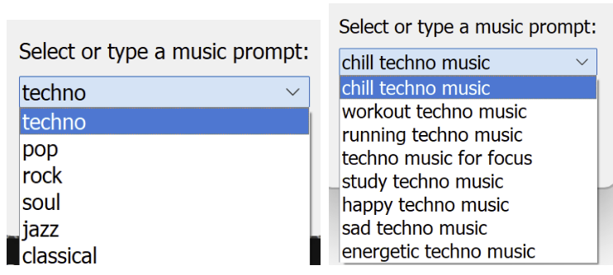
Latent Space > Audio Decoder
Base Prompt Selected, Customized
Processed activity injected base prompt
Current system resamples & prompts new musicgen every 15 sec
Prompt Example:
“Chill techno music. Current activity: Working at Desk. The listener is 34 years old, 182 cm tall, and weighs 78.0 kg. Heart rate is 64 bpm. Compose music that reflects the listeners style and physiological state. The track should begin with a seamless lead-in, evolving naturally from previous activity and ending naturally for the next activity.”
Prompt Job
Prev Worker (Cancellation)
Worker Generation
Fragment Queue

Slide 12
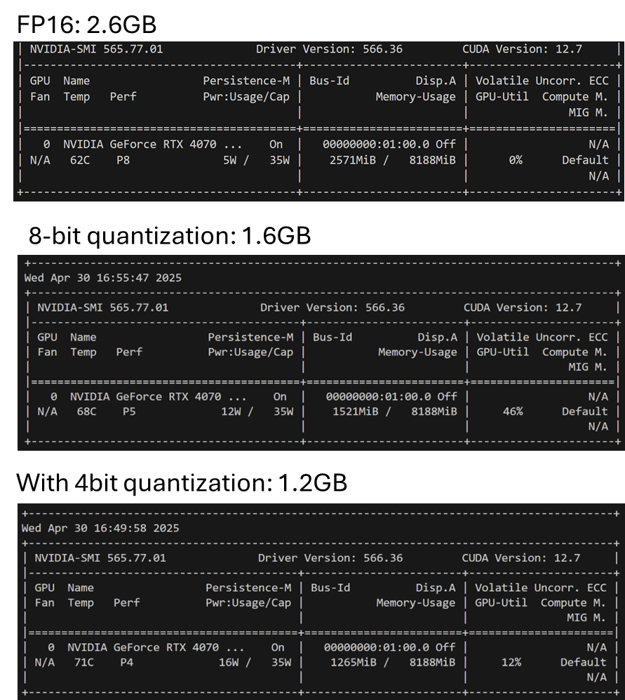
MusicGen Inference
(Testing on RTX 4070 8GB, ~30 fp16 TOPS)
8-bit would fit on mobile device…
bitsandbytes gives minimal speedup (~1.25x)
noticeable decrease in audio quality
4-bit sounds terrible (scratchy)
VS
Cloud offloading(40-180ms round-trip latency):
Modern VM GPU (125-300 fp16 tops, V100/A100)
Not worth generating chunks on-device. 180ms latency is negligible compared to init-prompt segment gen. time (0.5-2sec)

Slide 13
Tackled Challenges
MusicGen Location: Runs on local machine, but slow, low scalability
MusicGen input: requires text, doesn’t take context without extensive under-the-hood work
Inference on Jetson: Ensure preprocessing consistency across train/test devices.
Network Streaming: Three-node streaming proves challenging.
Queue Management: Without effective queue & worker dynamics, asynchronous threads produce disordered queue on transitions

Slide 14
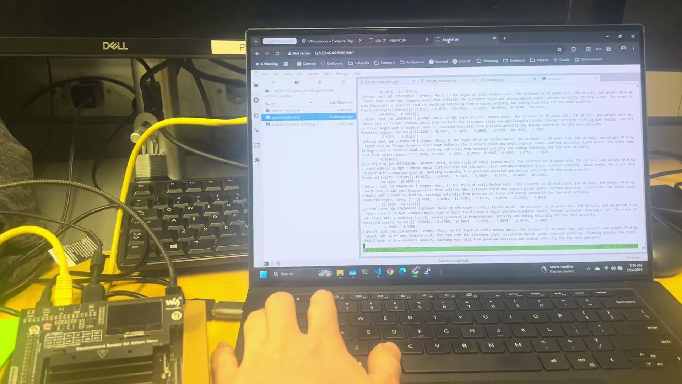

Streaming Results: Activity Test Data
MusicGen on V100, fp16 prec.
(2sec fragment length)
Live Stream lagging by ~0.5sec
Solvable* with high-power gpu
High Timbral Disparity between prompted segments
* associated system costs need addressable-market analysis

Slide 15

Future Work
Smooth Activity Transitions: Provide context to token-audio decoder (MusicGen fork)
Latency Minimization:
Increase VM compute power (ex streaming app: H200 w/800 fp16 TOPS! [5]).
Investigate communication costs & network/architecture variants.
Product Design: Value vs Cost Study, Addressable Markets & Technology Orientation
Data Acquisition buildout on target device (Fig. 6.1)
Develop SigLIP inference: train w/acquired data, introduce synthetic chaos in annotations.
Sensitivity:
Encoder+prompt embedding input as opposed to text prompt (large-scale SigLIP training, MusicGen fork): Smooth encoder embedding changes (as opposed to stark transitions in activity classifications) will produce more subtle differences in MusicGen passes while maintaining interpretability.
Tune token spread & activity context. Can use custom tuners (UI ‘knobs’)
Personalization: MusicGen policy, encoder/embedding rl through personalized feedback
Large-scale Streaming: KNN segment hacks, deviance detection, query initiation

Slide 16
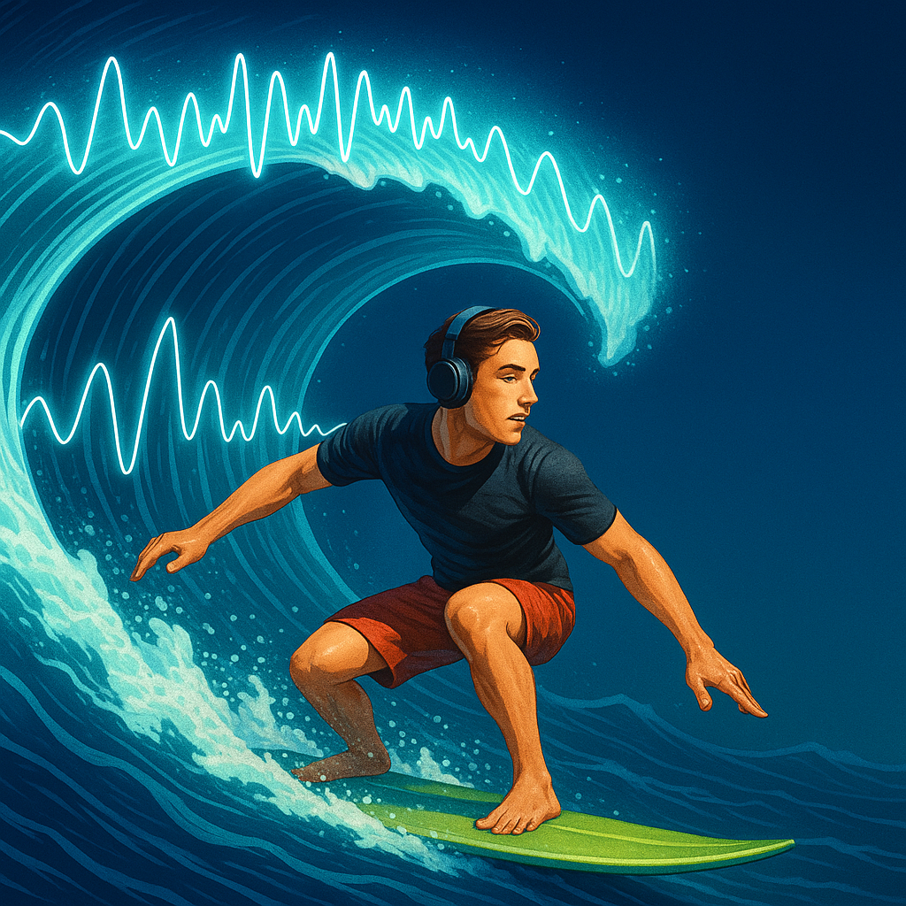
Join Us!
Let’s Discuss…
roles, responsibilities, & incentives

Slide 17
Appendix

Slide 18
Anticipated Results
“insane swelling music in the style of mozart, designed for a cycling sprint. End of the race, all power on!”
https://suno.com/song/661a5d23-17a9-4250-8fb1-e99d1f2d1e86?sh=ML0eM146ge964u1h

